Slide 1
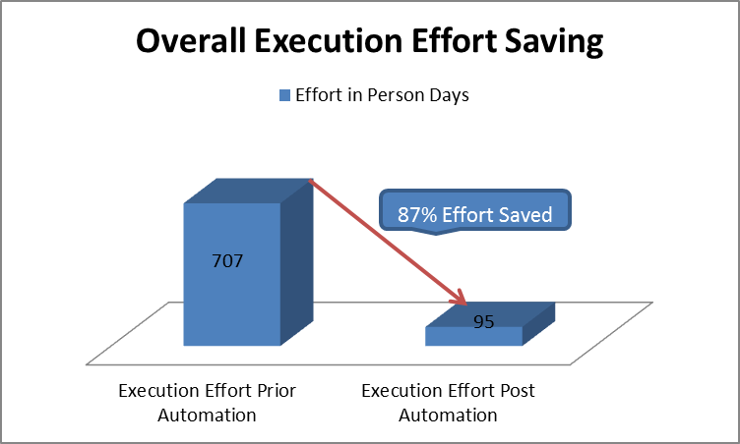
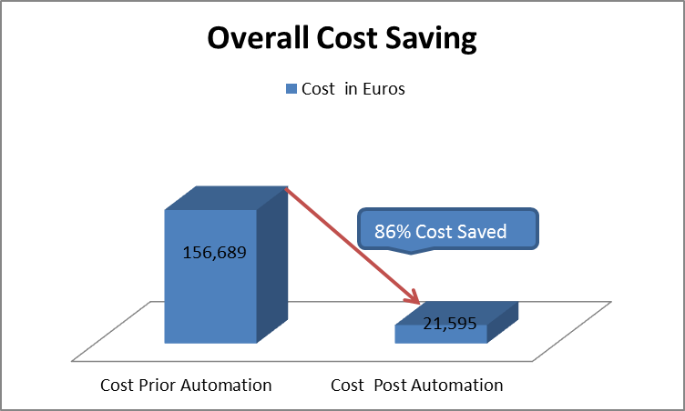
Summit- Case Study
QA Testing
Summit is a third-party Trading System application developed by Misys. Summit interfaces with following upstream systems: MarkitWire, Tsar, Trade Link, iTrac, ABFi, iconnector and with following downstream systems: 3D Cash/CRE, Thunderhead and GOLD, Trade Finder, iFaces.
Summit Team is involved in QA Support for Summit 3.8 since 2003,Summit 5.3 since 2011 , Summit 5.6 since 2014 and has developed many value adds by gaining summit capabilities and knowledge.
Business Objectives
Solutions
Execution Effort and Cost Saving
Reduce overall effort for test cycles by automation during Functional and regression testing.
Deploying the common testing methodology to increase test coverage and test quality.
Use Back end automation testing solution to reduce the test execution time when UI is not ready
Validate DB Capacity in the time of Batch Validation
Submitted 100,000 Transaction to validate DB capacity in matter of few hours using HP Service Test
Reduced Repeated Manual Effort in getting Member Information like Account Details, Deposit Risk Score Details using Web Service
Used Web Service to cover Functional Test Case whenever issue with Environment which is not directly impact AUT like Login Issue
Business Rules like Email Format Issue etc.. are validated at Web Service level
Scope
Critical Success Factors
Functional Testing (Manual)
Regression Testing (Manual and Automation)
Reduced Testing Execution Phase during Functional and Regression Testing
Covering Maximum number Test scenario combination
Tools
UFT (HP Service Test)
SoapUI
Java API
Innovations &Benefits
UTP Diffing value add of 13K EUR delivered
Engagement Model/Size
Onsite-Offshore: 2:12
Duration– Jan’12 – Dec’15

